Slide 1
Post Graduate Program - Data Science In Partnership With Purdue University
Course Project - Data Science with Python California Housing Price Prediction
Submitted by:
Lavkush Singh
Submitted to:
Purdue University – Simplilearn

Slide 2
Agenda
Introduction
Dataset Summary
Exploratory Data Analysis – Column Variables
Exploratory Data Analysis – Columns w.r.t New Feature
Correlation Matrix
Predictive Model Analysis
Predictive Model Summary
Appendix

Slide 3
Introduction
California Census Data published by US Census Bureau
Dataset has 10 types of metrics such as the population, median income, median housing price, and so on for each block group in California.
There are 20,640 districts in the project dataset.
This is Supervised – Regression Problem
This project aims at building a model of housing prices to predict median house values in California using the provided dataset.
Linear Regression is used to report the results. However, Random Forest Regressor is also used for comparison purpose.

Slide 4
Dataset Summary
20640 observations (rows) of 10 variables (columns)
‘total_bedrooms’ column had 207 missing values, median value is imputed
All the columns were numerical except ‘ocean_proximity’ column which had 5 categories.
One hot encoding was used to pre-process ‘ocean_proximity’ column
Numerical column values varies in scale and range
Data has skewed distributions. It is visually presented in the code file, however it is not accounted because the tasks given were pre-defined, and was not a part of ‘Analysis Tasks to be performed’

Slide 5
Exploratory Data Analysis Column Variables

Slide 6
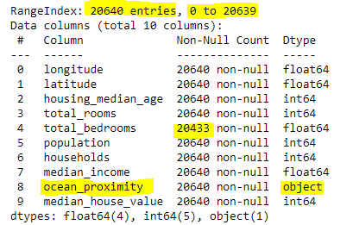
Understanding Data – Datatypes, Dimension, Null Values Summary

Slide 7
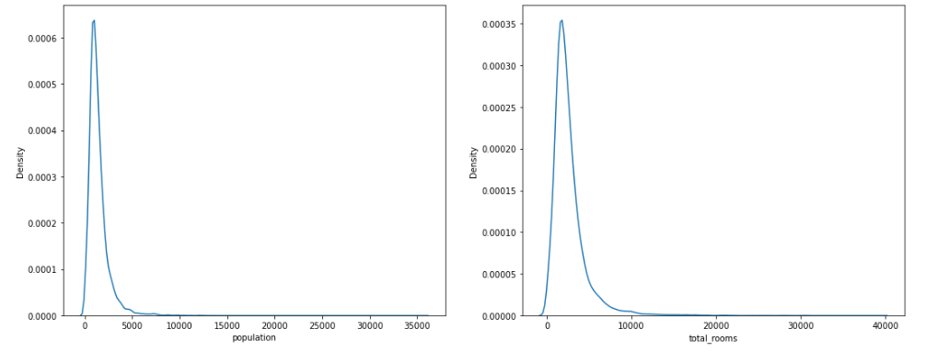
Distribution – ‘population’, ‘total_rooms’

Slide 8
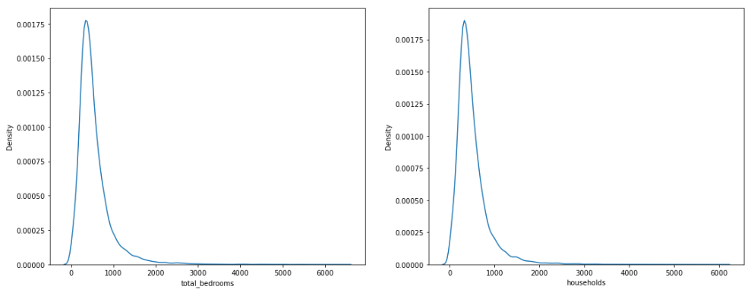
Distribution – ‘total_bedrooms’, ‘households’

Slide 9
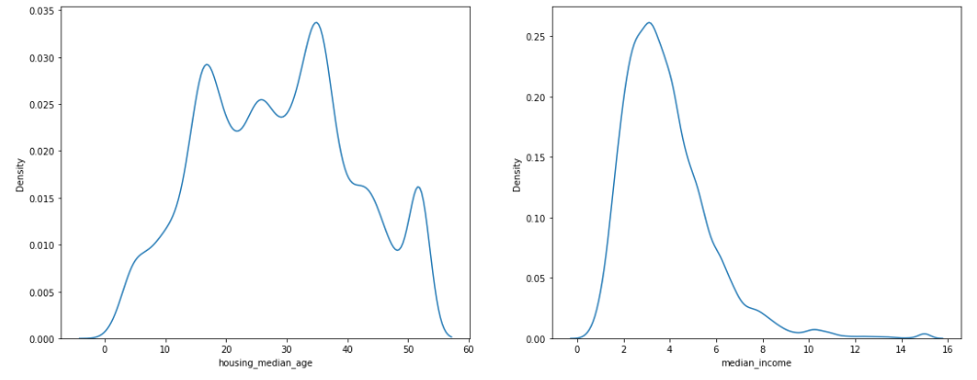
Distribution – ‘housing_median_age’, ‘median_income’

Slide 10
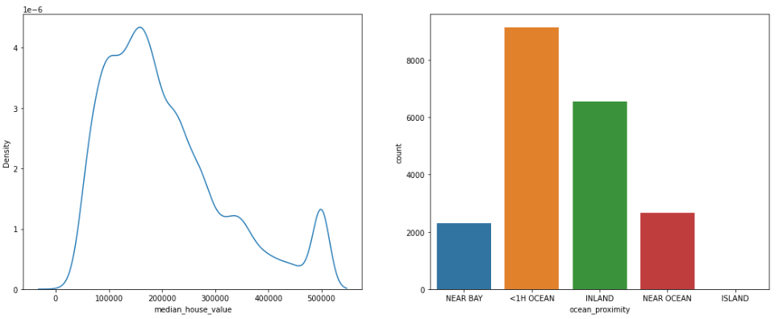
Distribution – ‘median_house_value’, ‘ocean_proximity’

Slide 11
Exploratory Analysis Summary
We have 10 columns and 20640 entries in dataset
‘total_bedrooms’ column has total of 207 missing observations
‘latitude’ and ‘longitude’ are spatial data columns
Columns – ['population', 'total_rooms', 'total_bedrooms', 'households’, ‘median_income’] has similar distribution – Right Tailed or Right Skewed Distribution
Columns - [‘housing_median_age’, ‘median_house_value’] has uneven distribution.
Column ‘ocean_proximity’ is categorical – of which houses near ‘<1H Ocean’ are highest and houses near ‘Island’ are lowest.

Slide 12
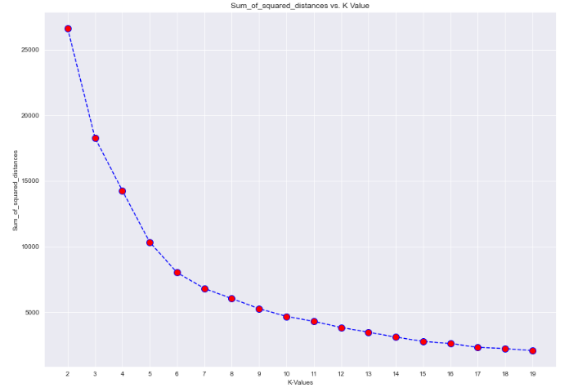
Exploratory Analysis Summary
‘latitude’ and ‘longitude’ columns has been converted to categorical column using KMeans Clustering Algorithm with K = 6 based on the below elbow method plot. (Refer code file submitted)

Slide 13
Exploratory Data Analysis Features based on Latitude-Longitude Clusters

Slide 14
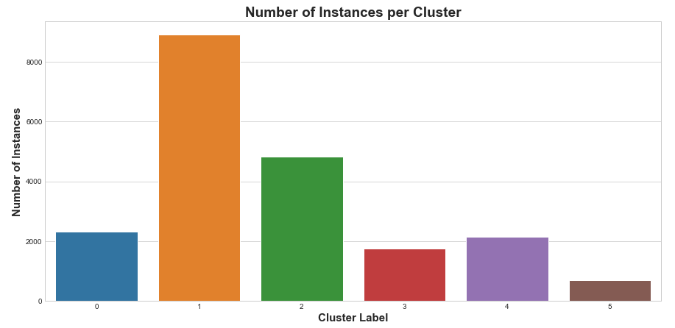
Exploratory Data Analysis

Slide 15
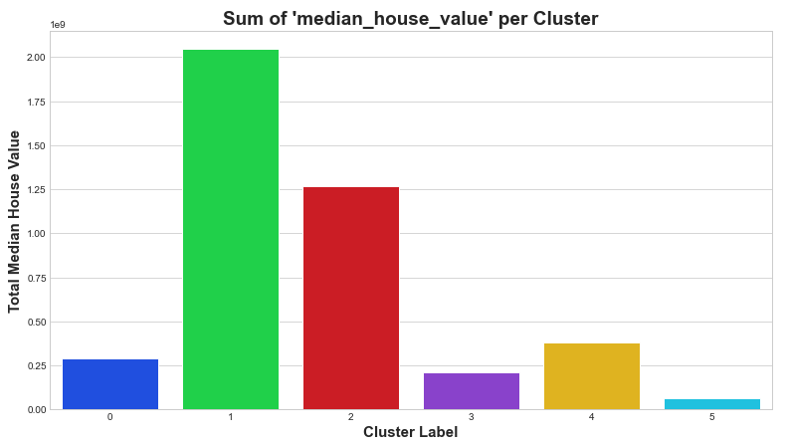
Exploratory Data Analysis

Slide 16
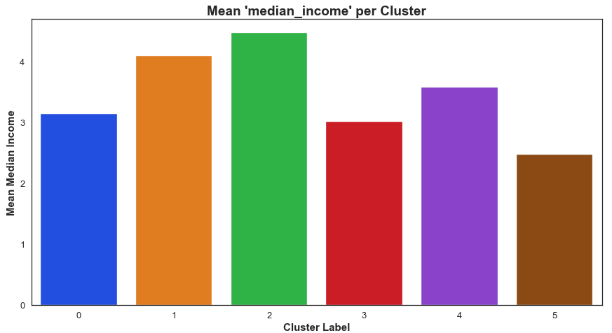
Exploratory Data Analysis

Slide 17
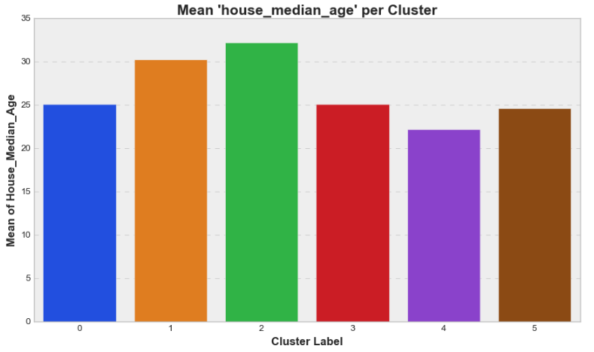
Exploratory Data Analysis

Slide 18
Exploratory Data Analysis Insights
Latitude and Longitude data has been converted to six clusters (0 to 5), based on KMeans Clustering Algorithm
Cluster 1 has highest number of instances, where as cluster 5 has lowest
Similar trend follows for sum of ‘median_house_value’. It means that the median house values (total) is more for cluster 1 and low for cluster 5
Population living in cluster 2 are rich, meaning their mean income is highest, and lowest is for people living in cluster 5
Oldest house of the city are located in cluster 1 and 2, where as newer houses have been constructed in rest of the clusters

Slide 19
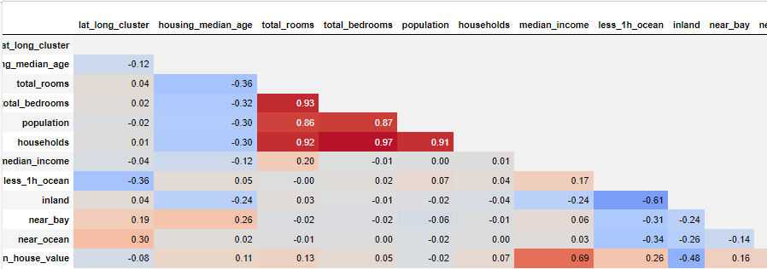
Correlation Matrix

Slide 20
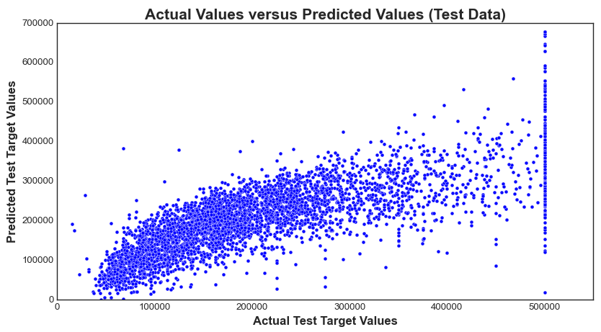

Linear Regression Model Analysis

Slide 21
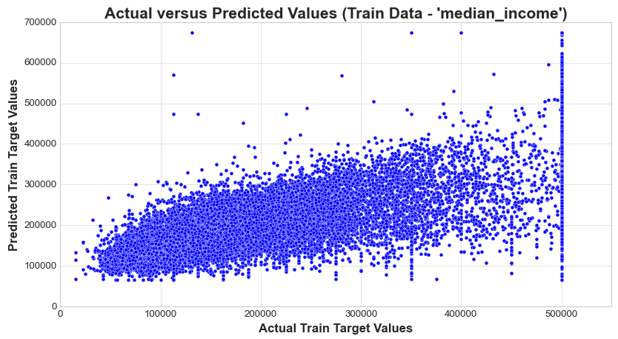
Linear Regression Model Analysis

Slide 22
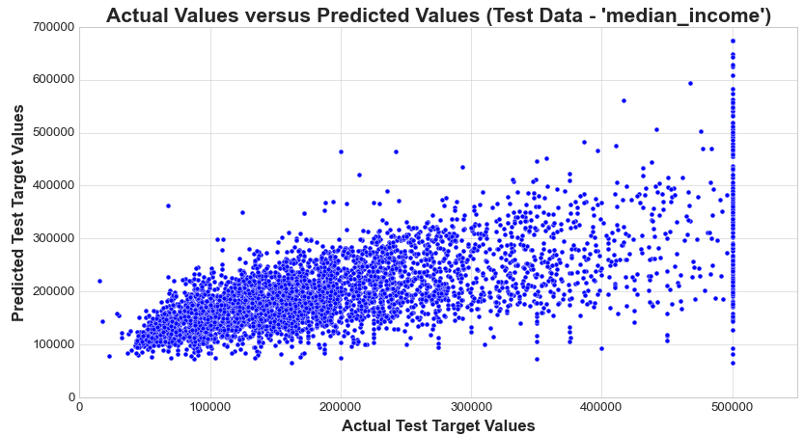
Linear Regression Model Analysis

Slide 23
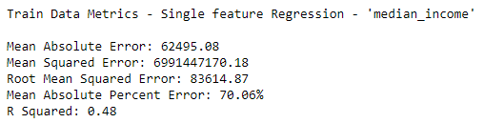
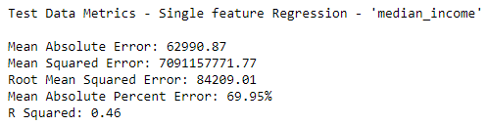
Linear Regression Model Analysis

Slide 24
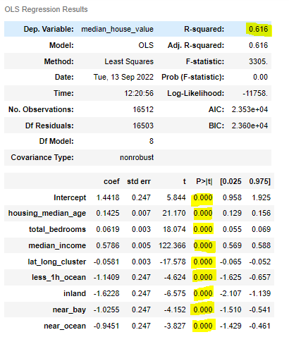
Linear Regression Model Analysis

Slide 25
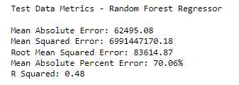
Linear Regression Model Analysis

Slide 26
Predictive (Linear) Model Summary
Regression Model did not perform well, has RMSE of 72405.12, MAPE 75.05% with R Square value of 0.6
Using only single feature (median_income), the model gives better result in terms of MAPE, but does error increases and the model explainability decreases. It has RMSE of 84209.01, MAPE 69.95% with R Square value of 0.46 for test data.
Comparing the regression metrics for single feature (median_income), of train and test data, observed that the metrics are almost same, which implies that data does not have problem of overfitting and underfitting, therefore, feature engineering is done well.
Random Forest Regressor, which is believed to be robust against outliers, was also build on the data, and it did not show much improvement. RMSE 83614.87, MAPE 70.06% and R Squared 0.48
However, future scope of predictive modelling could be to test out other ensemble models, cross validation techniques, further feature engineering and to get more relevant data.

Slide 27
Appendix
Please refer ‘California Housing Price Prediction-Lavkush.pdf’ file, submitted along with this PPT
Because the code was developed in jupyter notebook, it has source code along with the detailed analysis and report
All the graphs included in this presentation can also be found in that project report
This PPT is just a glimpse of the analysis done, for quick reference. Detailed work is present in the project report – “California Housing Price Prediction-Lavkush.pdf”.

Slide 28
Thank you!

